Slide 1
Modular Extension of Domain-specific Languages
Thomas Degueule
Software Analysis & Transformation
CWI
https://tdegueul.github.io
CWI Scientific Meeting
24 November 2017

Slide 2


Foreword
Joint work with the DiverSE group @ Inria
CWI—Inria associate team Agile Language Engineering (ALE)
20th ACM/IEEE International Conference on
Model-driven Engineering Languages and Systems

Slide 3
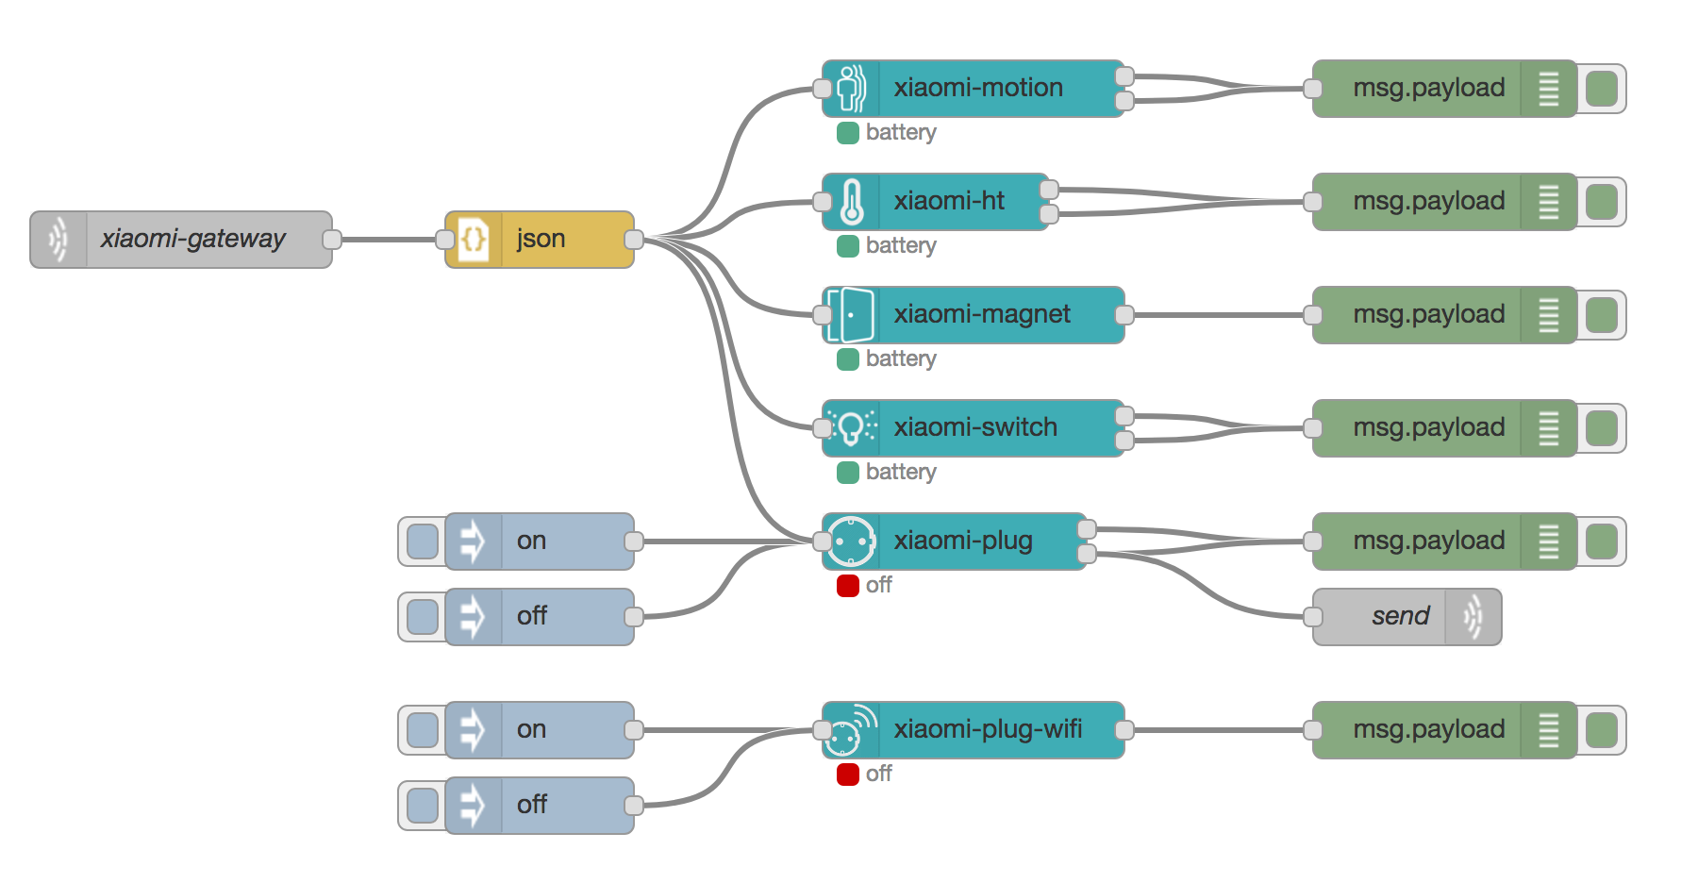
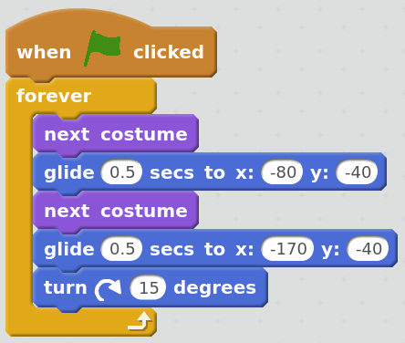
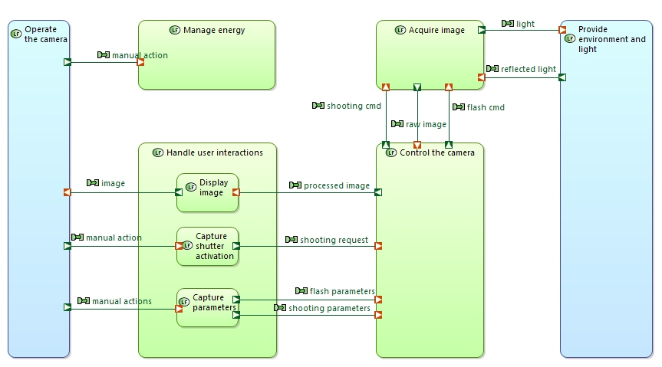
library IEEE;
use IEEE.std_logic_1164.all;
-- this is the entity
entity ANDGATE is
port (
I1 : in std_logic;
I2 : in std_logic;
O : out std_logic);
end entity ANDGATE;
-- this is the architecture
architecture RTL of ANDGATE is
begin
O <= I1 and I2;
end architecture RTL;
Node-RED
Wiring the Internet of Things
VHDL
Hardware Description Language
Scratch
Programming for Kids
Capella
Systems Engineering Language
Notes:
Bridge the gap between domain abstractions and their implementation in a programming language.

Slide 4
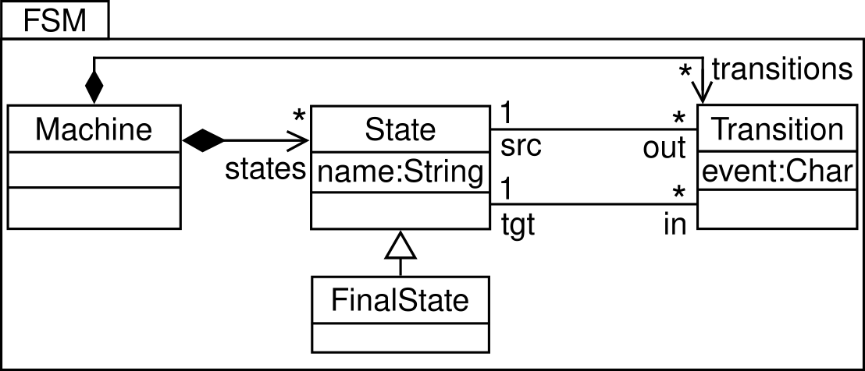
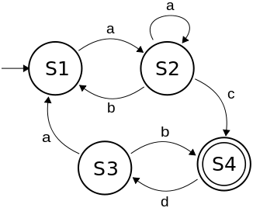
Abstract Syntax
step(State s, String evt) {
val next = s.outgoing.filter[event == evt]
if (next.size == 0)
throw new DeadlockException
if (next.size > 1)
throw new IndeterminismException
next.head.fire()
}
Execution Semantics
Concrete Syntax

Slide 5

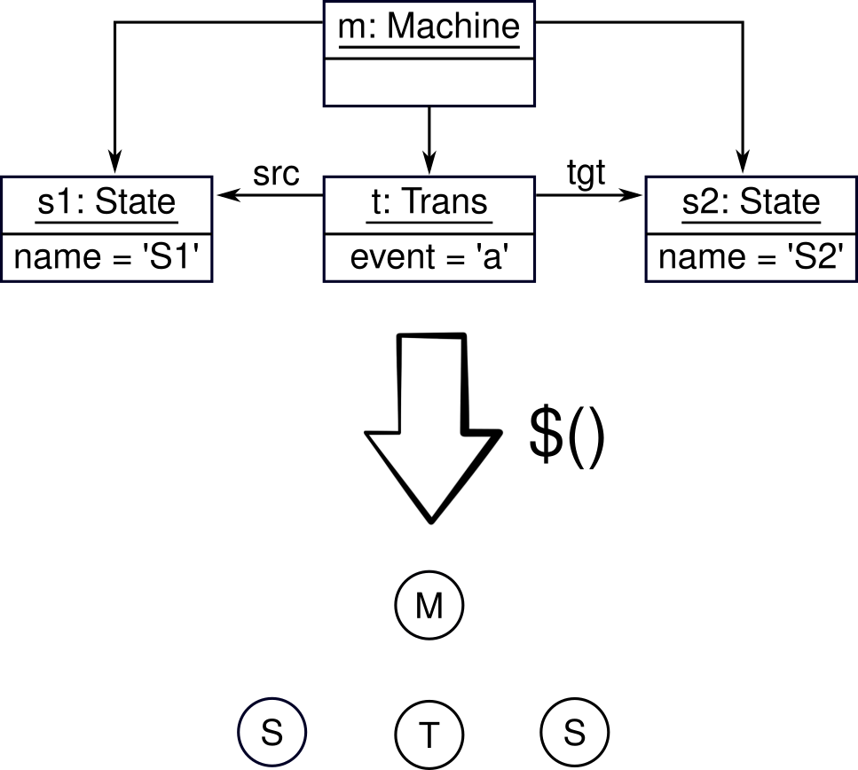
class Machine { List<State> states; […] }
class State { String name; […] }
class Trans { char event; […] }
class FS extends State { […] }
AST Classes
Abstract Syntax
step(State s, String evt) {
val next = s.outgoing.filter[event == evt]
if (next.size == 0)
throw new DeadlockException
if (next.size > 1)
throw new IndeterminismException
next.head.fire()
}
Execution Semantics

Slide 6
class Machine { List<State> states; […] }
class State { String name; […] }
class Trans { char event; […] }
class FS extends State { […] }
AST Classes
Abstract Syntax
interface Interpret { void interpret(); }
class Machine implements Interpret { […] }
class State implements Interpret { […] }
class Trans implements Interpret { […] }
step(State s, String evt) {
val next = s.outgoing.filter[event == evt]
if (next.size == 0)
throw new DeadlockException
if (next.size > 1)
throw new IndeterminismException
next.head.fire()
}
Interpreter Pattern
class Machine { void accept(Visitor v); }
class State { void accept(Visitor v); }
class Trans { void accept(Visitor v); }
interface Visitor {
void visit(Machine m);
void visit(State s);
void visit(Transition t);
}
class ExecMachine implements Visitor {
void visit(Machine m) { […] }
void visit(State s) { […] }
void visit(Transition t) { […] }
}
Execution Semantics
Visitor Pattern

Slide 7


class Machine { List<State> states; […] }
class State { String name; […] }
class Trans { char event; […] }
class FS extends State { […] }
AST Classes
Abstract Syntax
interface Interpret { void interpret(); }
interface Print { void print(); }
class Machine implements Interpret { […] }
class State implements Interpret { […] }
class Trans implements Interpret { […] }
step(State s, String evt) {
val next = s.outgoing.filter[event == evt]
if (next.size == 0)
throw new DeadlockException
if (next.size > 1)
throw new IndeterminismException
next.head.fire()
}
Interpreter Pattern
interface Visitor { […] }
class ExecMachine implements Visitor {
void visit(Machine m) { […] }
void visit(State s) { […] }
void visit(Transition t) { […] }
}
class PrintMachine implements Visitor {
void visit(Machine m) { […] }
void visit(State s) { […] }
void visit(Transition t) { […] }
}
Execution Semantics
pretty-print(State s) {
print(“State “ + s.name)
print(“Transitions:”)
for (t in s.transitions)
pretty-print(t)
}
Printing Semantics
Visitor Pattern

Slide 8
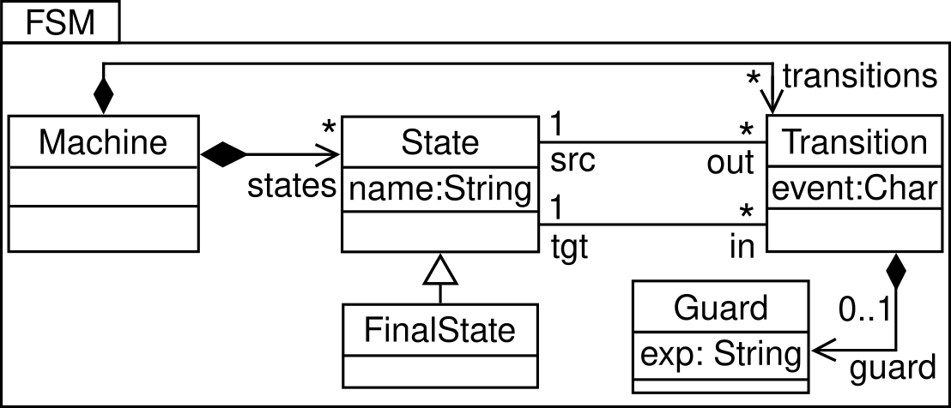
class Machine { List<State> states; […] }
class State { String name; […] }
class Trans { char event; […] }
class FS extends State { […] }
class Guard { String exp; […] }
AST Classes
Abstract Syntax
interface Interpret { void interpret(); }
class Machine implements Interpret { […] }
class State implements Interpret { […] }
class Trans implements Interpret { […] }
class Guard implements Interpret { […] }
step(State s, String evt) {
val next = s.outgoing.filter[event == evt]
if (next.size == 0)
throw new DeadlockException
if (next.size > 1)
throw new IndeterminismException
next.head.fire()
}
Interpreter Pattern
interface Visitor {
void visit(Machine m);
void visit(State s);
void visit(Transition t);
void visit(Guard g);
}
class ExecMachine implements Visitor {
void visit(Machine m) { […] }
void visit(State s) { […] }
void visit(Transition t) { […] }
void visit(Guard g) { […] }
}
Execution Semantics
Visitor Pattern

Slide 9
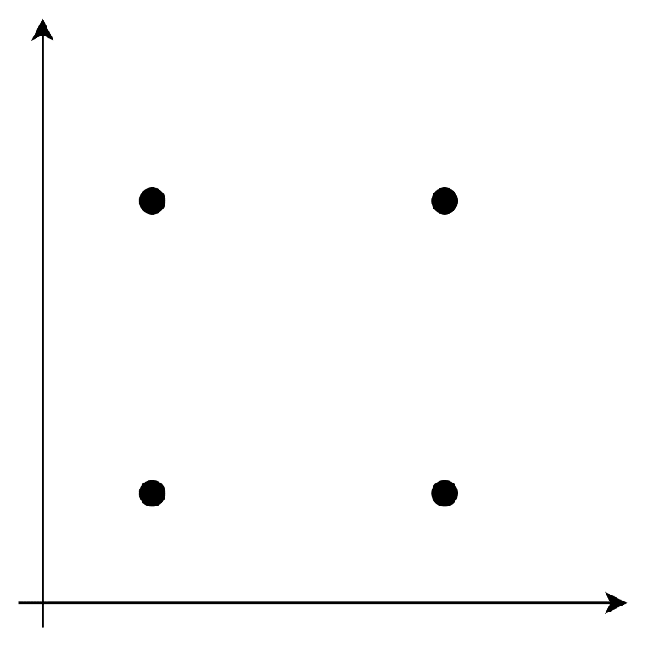
Challenges of Modular Extension
The Expression Problem
Philip Wadler
1998
How to extend (syntax and semantics of) DSLs
Without anticipating the extension
Without modifying or duplicating existing code
While ensuring type safety
Semantics
ExecFSM
ExecGuardedFSM
FSM
GuardedFSM
Syntax

Slide 10
The Revisitor Pattern

Slide 11
Revisitor Interface
Maps syntactic objects to semantic objects
interface FsmRev<M, S, F extends S, T> {
M machine(Machine it);
S state(State it);
F fState(FState it);
T trans(Trans it);
default M $(Machine it) { return machine(it); }
default F $(FState it) { return fState(it); }
default T $(Trans it) { return trans(it); }
default S $(State it) {
if (it instanceof FState)
return fState(it);
return state(it);
}
}

Slide 12
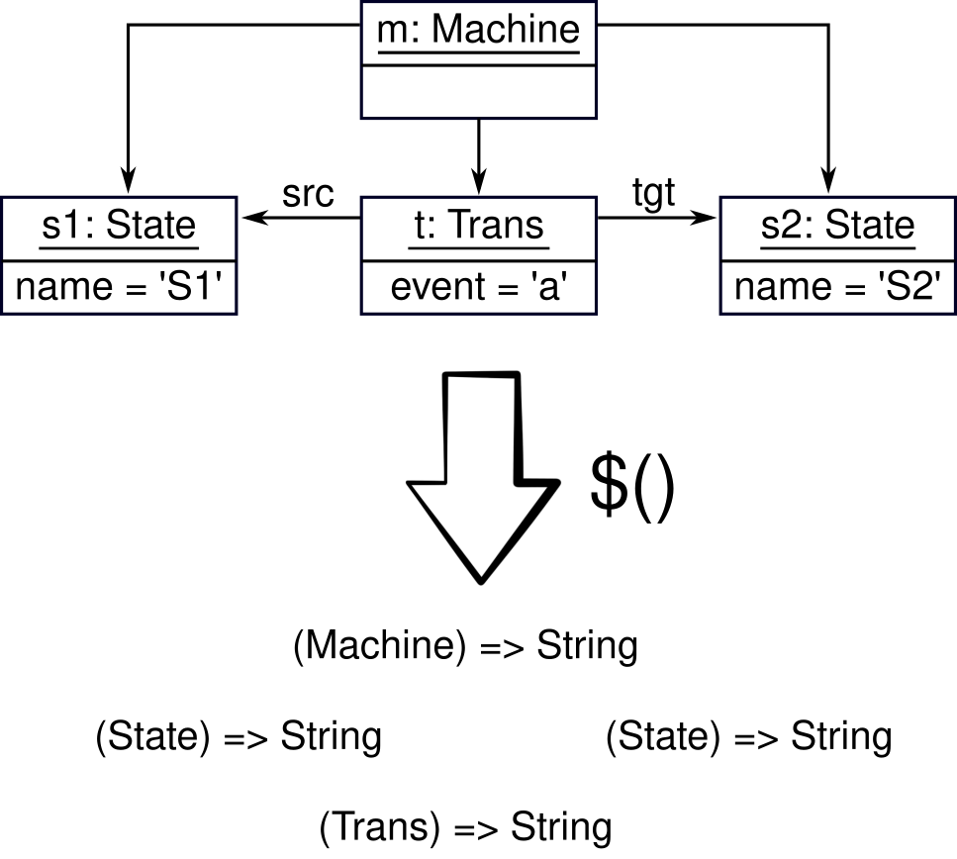
Revisitor Implementation
Implements the semantic objects
interface Pr { String print(); }
interface PrintFsm extends FsmRev<Pr, Pr, Pr, Pr> {
default Pr machine(Machine it) {
return () -> it.name + “:\n” +
it.states.map(s -> $(s).print());
}
default Pr state(State it) {
return () -> /* print a state */;
}
default Pr fState(FState it) {
return () -> /* print a final state */;
}
default Pr trans(Trans it) {
return () -> /* print a transition */;
}
}

Slide 13
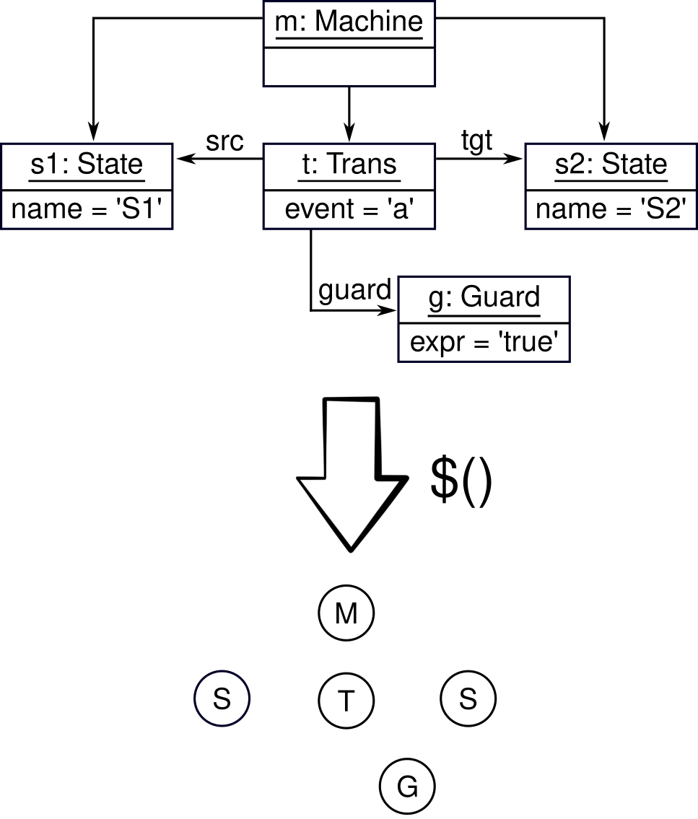
Modular Extension with Revisitors

Slide 14
Modular Extension with Revisitors
interface GuardFsmRev<M, S, F extends S, T, G>
extends FsmRev<M, S, F, T> {
G guard(Guard it);
default G $(Guard it) { return guard(it); }
}
Extend the (existing) mapping

Slide 15
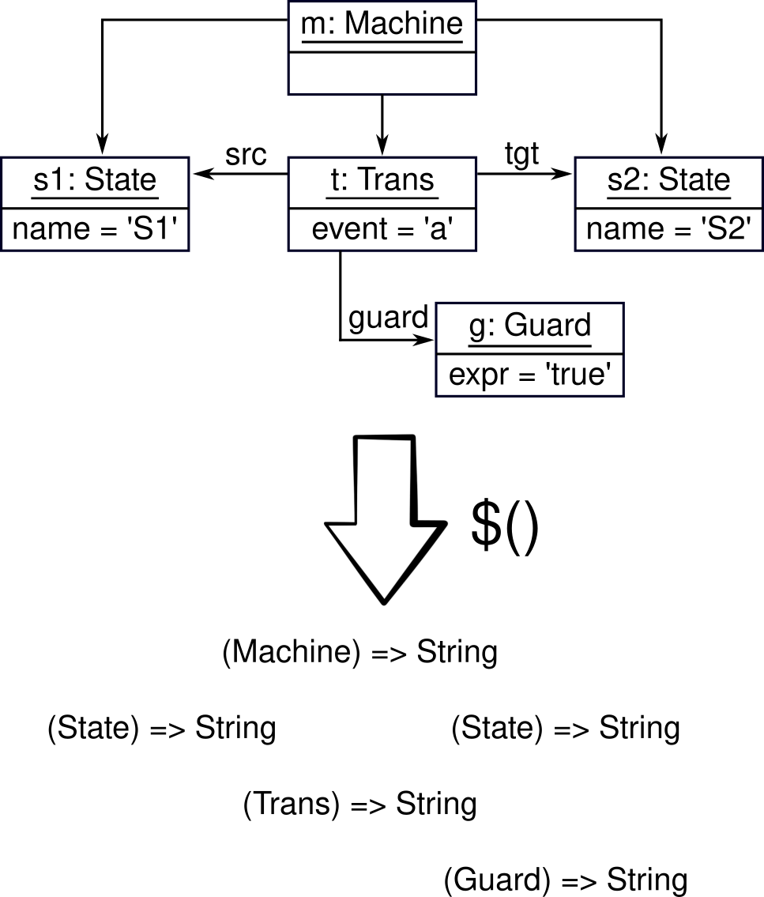
Modular Extension with Revisitors
interface GuardFsmRev<M, S, F extends S, T, G>
extends FsmRev<M, S, F, T> {
G guard(Guard it);
default G $(Guard it) { return guard(it); }
}
Extend the (existing) mapping
interface PrintGuardFsm
extends PrintFsm,
GuardFsmRev<Pr, Pr, Pr, Pr, Pr> {
default Pr guard(Guard it) {
return () -> /* print a guard */;
}
}
Extend the (existing) semantics

Slide 16
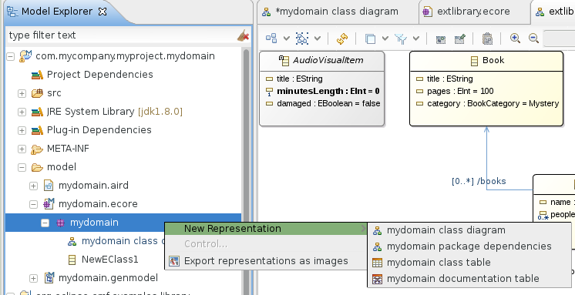



ALE: the Action Language for EMF
open class Machine {
def String print() {
String ret = "";
for (State s in self.states)
ret = ret + $[s].print();
return ret;
}
}
open class State {
def String print() { /* ... */ }
}
open class FinalState {
def String print() {
return "*" + $[super].print();
}
}
open class Transition {
def String print() {
return self.event + "=>" + self.tgt.name;
}
}
[EclipseCon’17] EcoreTools Next:
Executable DSL made (more) accessible
Printing FSMs in ALE
https://tinyurl.com/ale-ecore

Slide 17

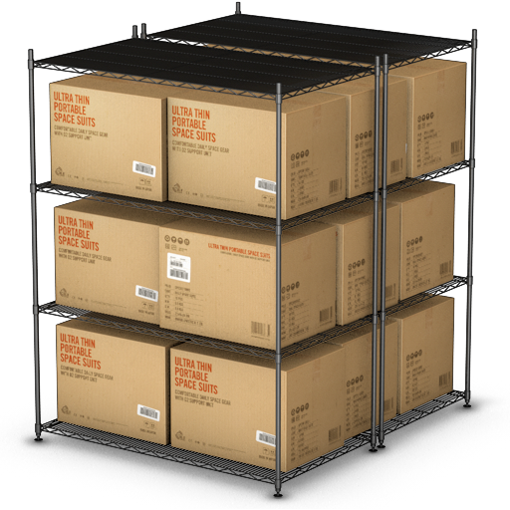
Wrap-up
The story so far
Independent and modular extensibility of syntax & semantics
With incremental compilation, without anticipation
Applicable in any “mainstream” OO language
The ALE language, soon™ in Eclipse, makes it user-friendly
What’s next?
Separate compilation is the first step towards language components
Off-the-shelf language components have explicit provided & required interfaces
Pick, assemble, and customize language components to create new DSLs
DSL₁
DSL₂
DSL_{n}
choose
produce

Slide 18
EOF

Slide 19
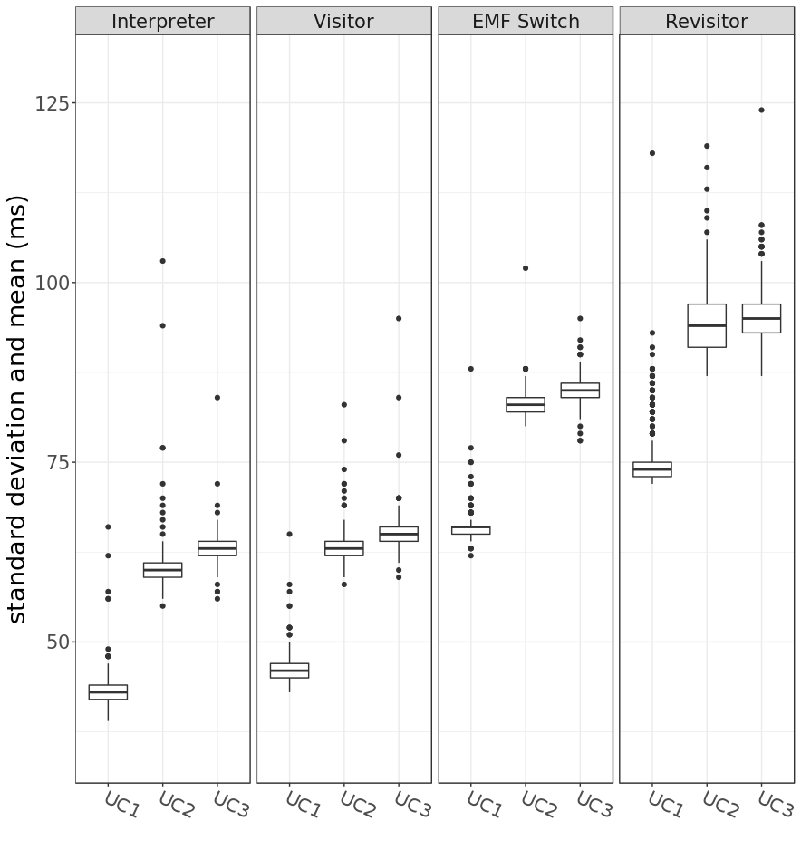
Performance Evaluation
SE is all about trade-offs
Same language, same semantics, different implementation techniques
Modularity outweigh performance in many scenarios

Slide 20
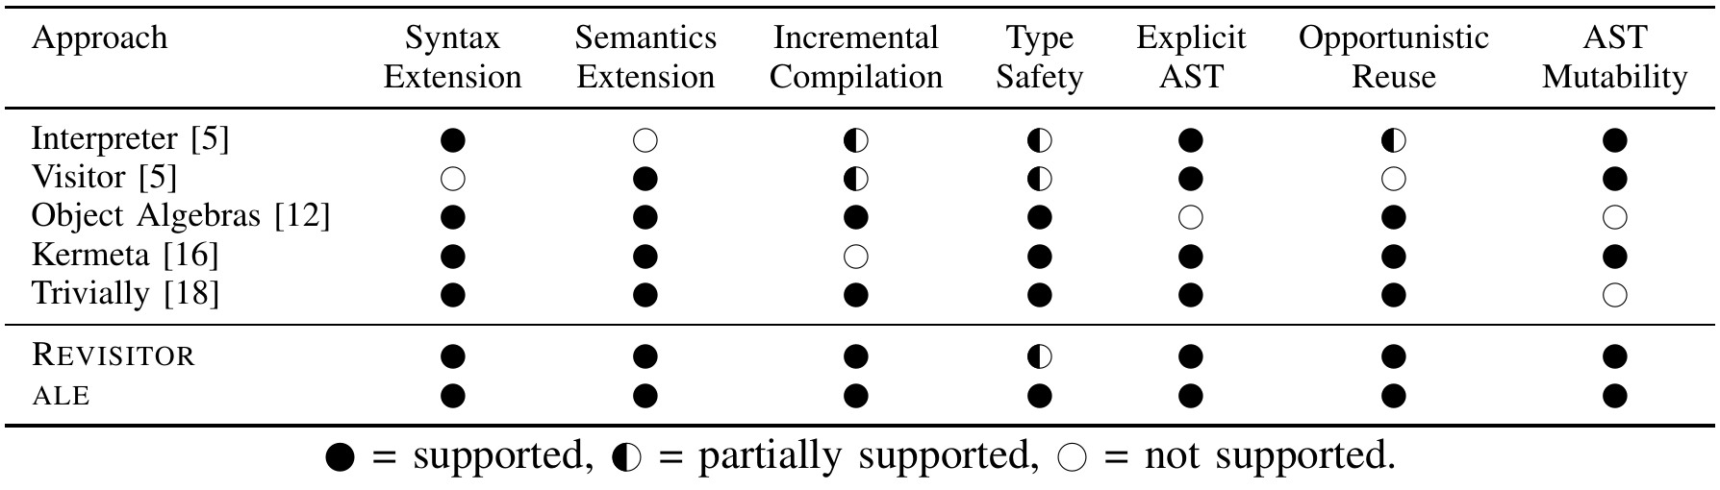
Challenges of Modular Extension
The Expression Problem
Philip Wadler
1998
How to extend (syntax and semantics of) DSLs
Without anticipating the extension
Without modifying or duplicating existing code
While ensuring type safety

Slide 21
Domain-specific Language Recipe
step(State s, String evt) {
val next = s.outgoing.filter[t | t.event == evt]
if (next.size == 0)
throw new DeadlockException
if (next.size > 1)
throw new IndeterminismException
next.head.fire()
}
Abstract Syntax
Execution Semantics
class Machine {
void execute(String[] events) { […] }
}
class State {
void step(String event) { […] }
}
class Transition {
void fire() { […] }
}
class Machine { void accept(Visitor v) }
class State { void accept(Visitor v) }
class Trans { void accept(Visitor v) }
interface Visitor {
void visit(Machine m)
void visit(State s)
void visit(Transition t)
}
class ExecMachine implements Visitor {
void visit(Machine m) { […] }
void visit(State s) { […] }
void visit(Transition t) { […] }
}

Slide 22
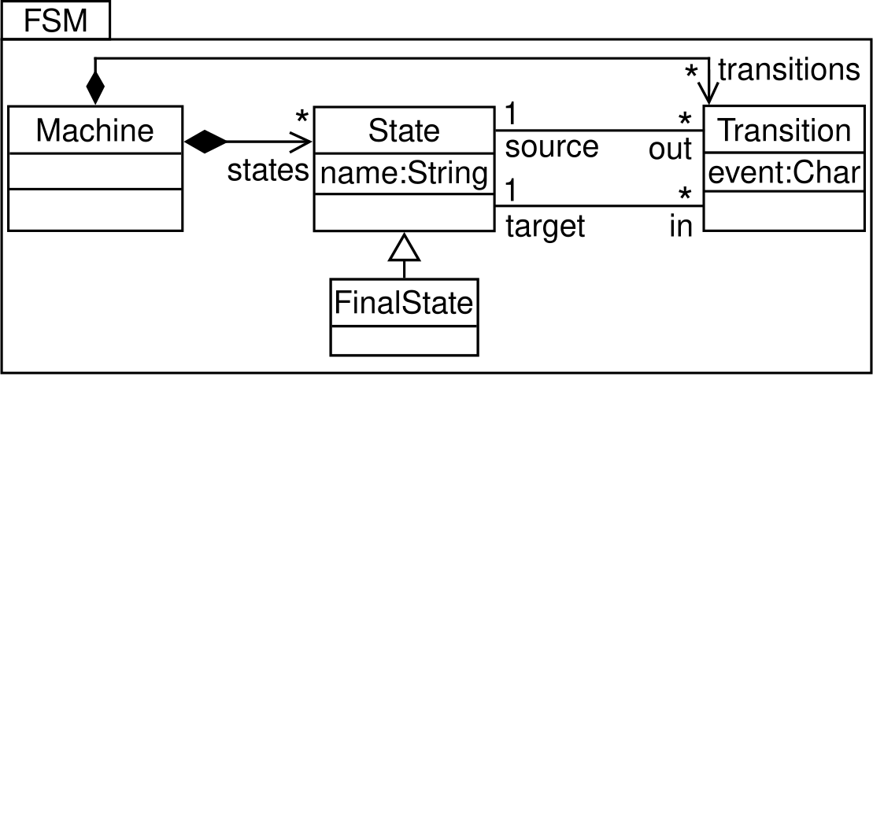
A Typical Language Extension Scenario
A simple FSM

Slide 23
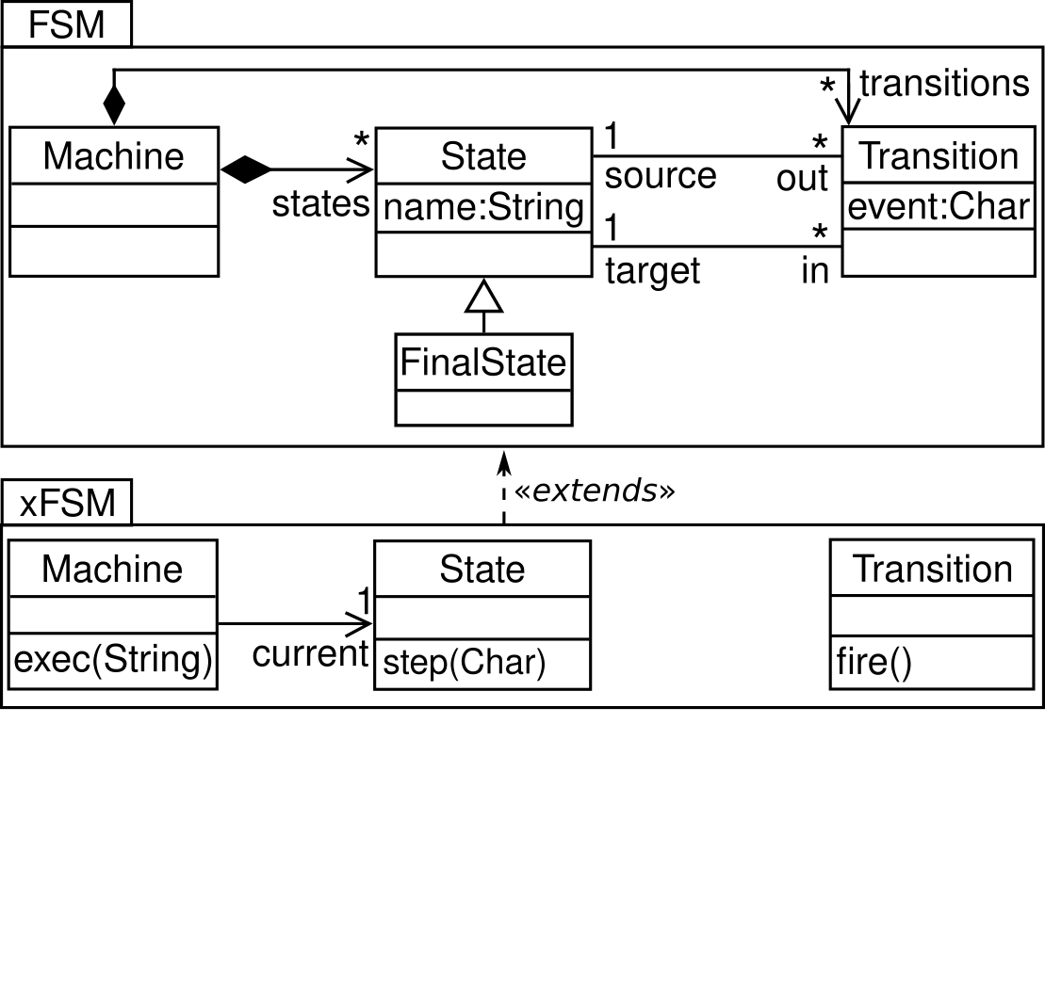
A Typical Language Extension Scenario
A simple FSM
With execution semantics

Slide 24
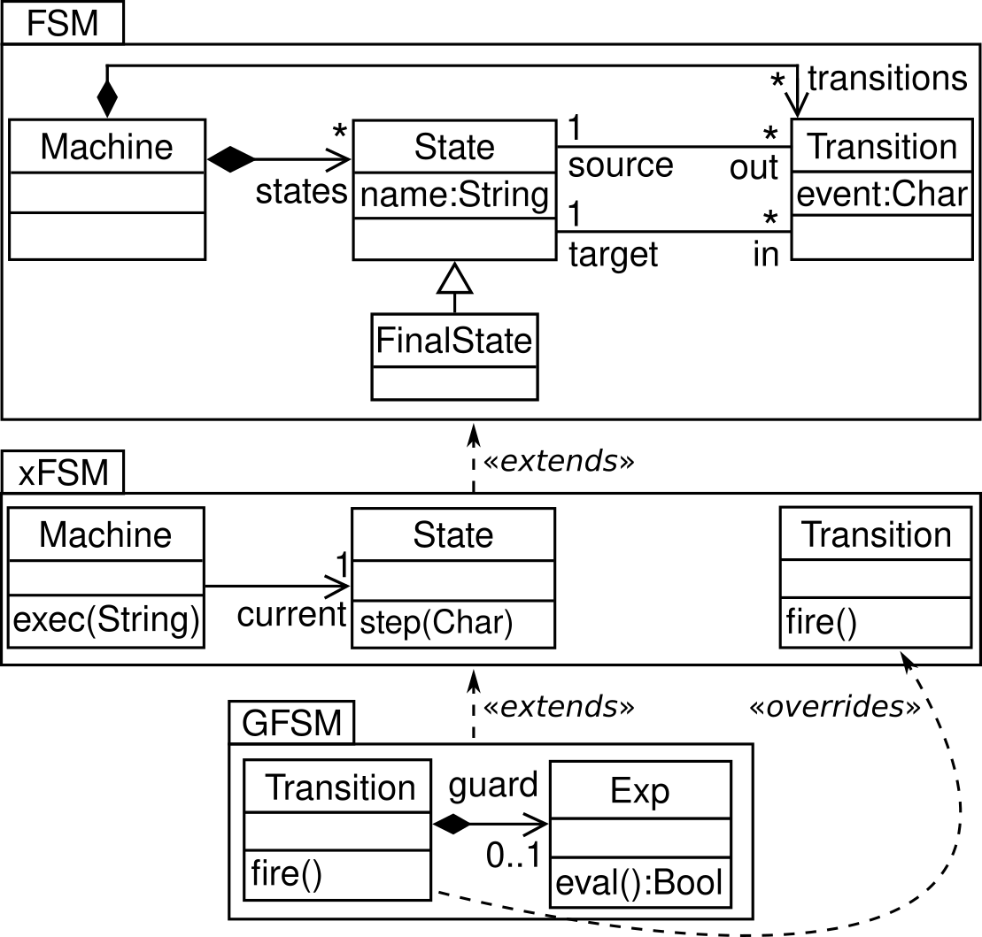
A Typical Language Extension Scenario
A simple FSM
With execution semantics
With guards

